Slide 1
6G4Z0024 Web Development Lecture 4: Scalable styling and introduction to JavaScript
Yanlong Zhang
Y.Zhang@mmu.ac.uk

Slide 2
Learning Objectives
To understand what we mean by responsive design and how we can make our websites responsive
To understand the basics of JavaScript and where JS is useful

Slide 3
Last week recap
CSS – make things pretty
CCS3 – make things exciting

Slide 4
Websites should be responsive…
What do we mean by responsive?

Slide 5
Responsive Design
A design that works and looks good on all devices, screen sizes, resolutions
The site will auto adjust accordingly to the viewport
The move to mobile-first design
Remember the scalable layout last week?
Scalable using percentages over fixed sizing

Slide 6
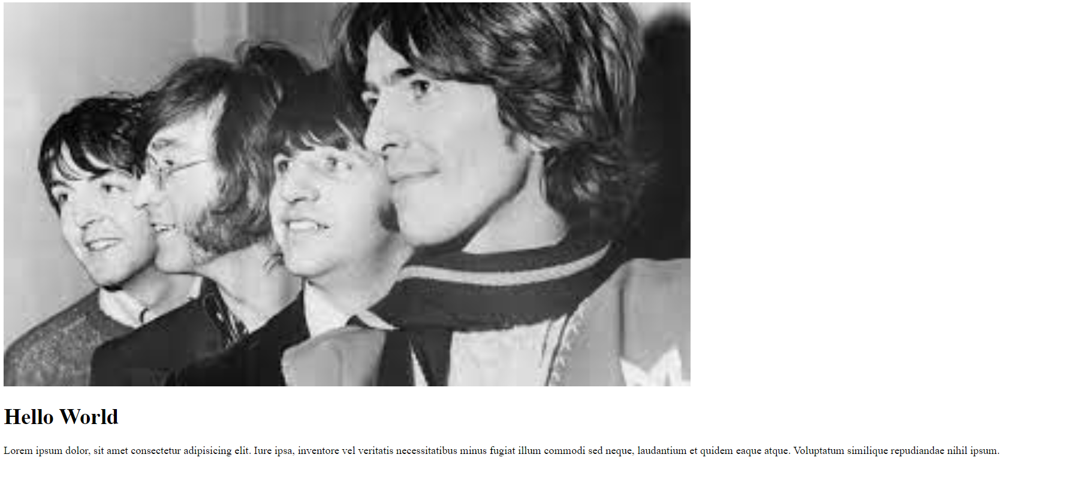
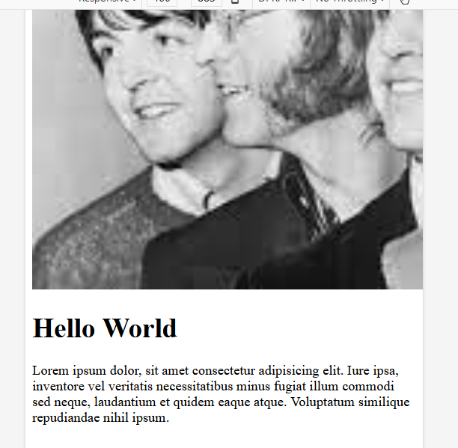
Example
This image has a width of 1000px.
While it looks ok on desktop, it is cropped on smaller screens

Slide 7
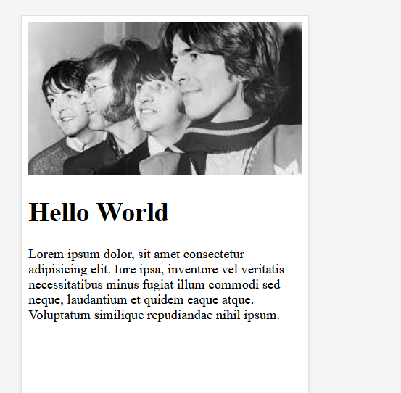

How do we make websites responsive?
Instead, we can set the width to 100%
Now the image scales with the screen size

Slide 8
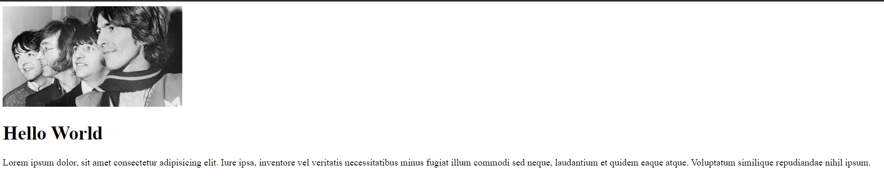

How do we make websites responsive?
However, on wide screens, the image now takes over an pixelates
We can instead use the max-width property
The image will scale down, but never scale up larger than its original size

Slide 9
How do we make websites responsive?
Viewport: the area of the window in which web content can be seen (often not the same size as the rendered page, so the browser applies scroll bars)
We can set the viewport to always be the same as the width of the current device

Slide 10
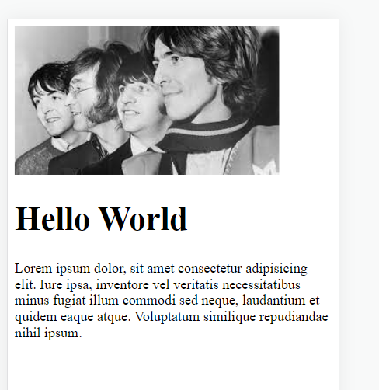
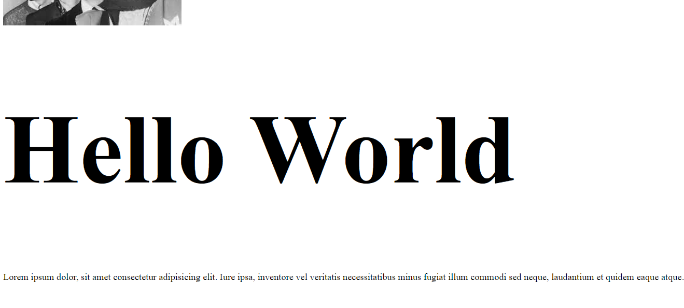
How do we make websites responsive?
For scalable elements and text, instead of using pixels, we can use viewport width and viewport height (vw and vh) to scale with the viewport

Slide 11
Layout frameworks: Flexbox
Rather than code everything from scratch, CSS includes some handy tools for building UI’s
Flexbox is one such framework
Flexbox allows you to dynamically allocate space in the viewport
You give each of your elements a flex number, the numbers are summed and the screen is divided by the total number, allocating the given proportions for each component

Slide 12

Layout frameworks: Flexbox
Source: https://www.youtube.com/watch?v=K74l26pE4YA&ab_channel=Fireship
Notes:
https://www.youtube.com/watch?v=K74l26pE4YA&ab_channel=Fireship

Slide 13
Layout frameworks: Flexbox
Flexbox is a lot to remember and to get your head around. Especially if you are new to it. However, there is a game to help you learn quickly and understand the concepts:
https://flexboxfroggy.com
You will be playing flexboxfroggy in the labs this week

Slide 14
How can we test our designs?
Most browsers allow you to test designs on multiple screen sizes
Open your website and in the settings, open the developer tools
You can change your device/screen size at the top of the page.

Slide 15
Other means for responsive design
Media queries
@media only screen and (max-width: 1000px) and (min-width: 700px) {
h1 { color: blue; }
#sect1 {float: left;
width: 25%;
}
}
Bootstrap
………
You can use Flexbox/Media queries to complete your assignment.
Bootstrap NOT allowed

Slide 16
Where are we up to?
HTML – defines the element of the content
CSS – allows us to make things pretty
Neither are “programming languages”
We need something that can handle all of the interactivity
Handle the form data
Turn our websites into web applications
Website: a group of globally accessible, interlinked pages (static)
Web App: software which is accessible using a web browser

Slide 17
JavaScript – the programming language of the web!
Welcome to JavaScript
Easy to learn
The world's most popular programming language
The language of the web
Program the behaviour of web pages
But, it can be a bit weird at times…

Slide 18
Linking JavaScript to your website
We store our JavaScript scripts in their own files (.js extension)
Like with CSS, we then import the script into our web pages
This can be done anywhere, but for this Unit, you can add it inside the <head> element
<script src="myScript.js"></script>

Slide 19
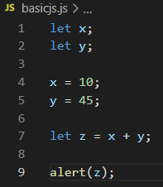
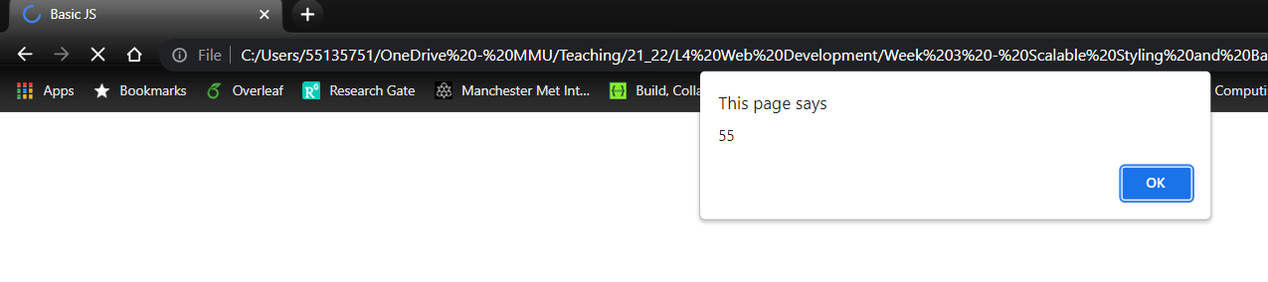
JavaScript Basics: variables
Variables declarations: use let or const
Variables aren’t typeset (like in Java), you can switch variables between different datatypes
Note, the page hasn’t loaded in the browser yet because the script runs in the <head>

Slide 20
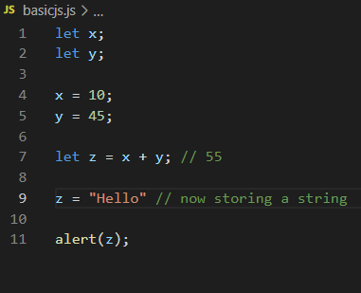
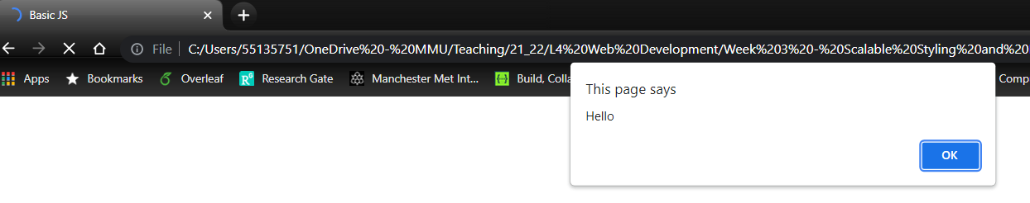
JavaScript Basics: variables

Slide 21
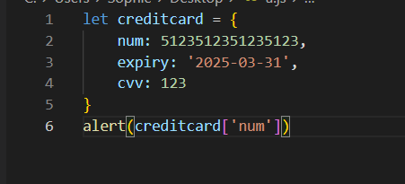
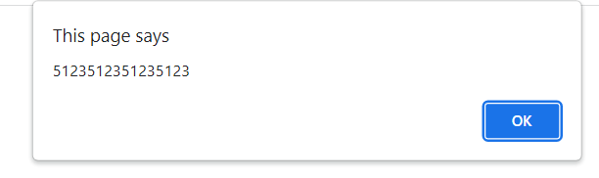
JavaScript Basics: Objects
JS objects are used a lot in application development
E.g. displaying large amounts of data, sending data to servers for processing
key/value pairs; comma separated

Slide 22

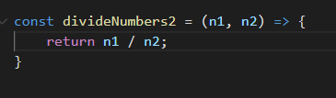
JavaScript Basics: Functions
There are two ways of writing functions
Arrow functions (on the right) are preferred, but both work
Why?
They are a little more flexible as we will see in later weeks.
For now, it would just be best you get used to them

Slide 23
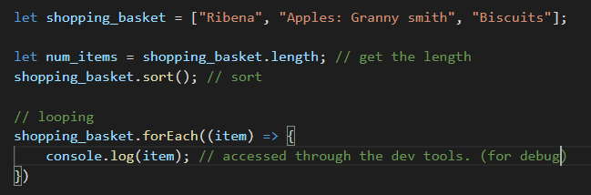
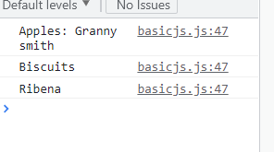
JavaScript Basics: Arrays
Note the arrow function here – this is an anonymous function (cleaner and quicker)

Slide 24
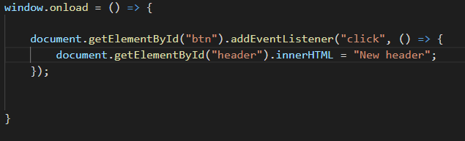
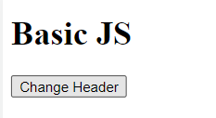
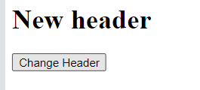
JavaScript Basics: Interaction
All very good, but how is it relevant to web site development?
Well, we can make our JS interact with our site, make changes to our site, and handle events (e.g. button clicks, page loads)
This means that we can essentially do anything with JS
Looks scarier than it is…

Slide 25
This week's lab
Learn to create responsive websites using flex
Start to play around with the basics of JavaScript

Slide 26
Sources
https://www.guru99.com/difference-web-application-website.html
https://www.w3schools.com/html/html_responsive.asp
https://www.w3schools.com/js

